Slide 1

Perception and Communication
Notes:
<number>
1
1
1

Slide 2
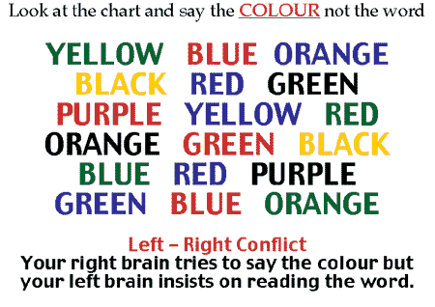

Slide 3
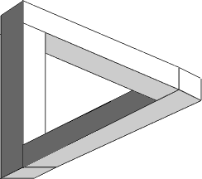
Perception Defined
The process by which we become aware of objects and events in the external world.
The process of making sense of the world around us.
Many people ignore the fact that all of us are different and that these differences equip us to view the world from our very own vantage points. Usually we spend more energy defending our own position than understanding others.
Where does the triangle begin?

Slide 4

Influences on Perception
Physiological (biological, neurological) Influences
Senses, age, health, fatigue, hunger, biological cycles
Social Influences
Cultural Differences
Nonverbal behaviors, odors, speech, silence, space
Social Roles
Sex roles, gender roles, occupational roles
Self-Concept
Self-esteem, locus of control, attribution (attaching meaning to behavior)

Slide 5
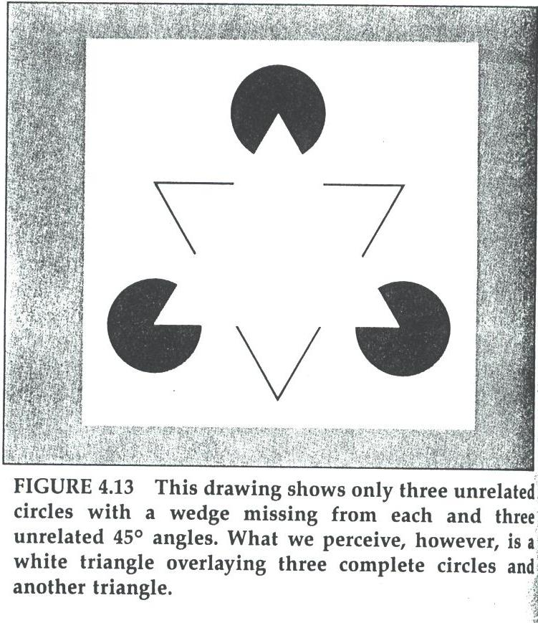

Slide 6


Slide 7
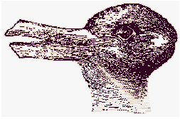
A Duck . . . Or a Rabbit?

Slide 8
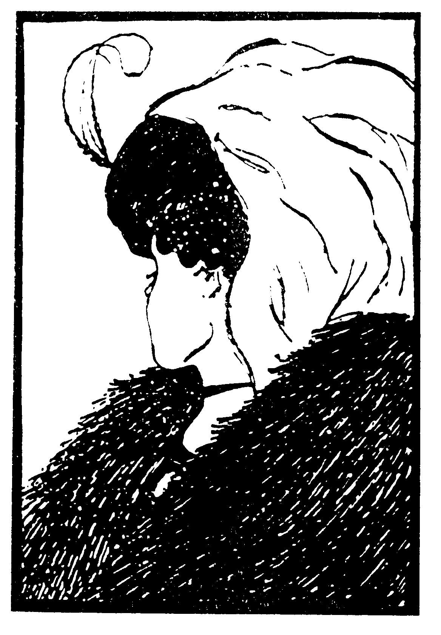
Young, or old?

Slide 9
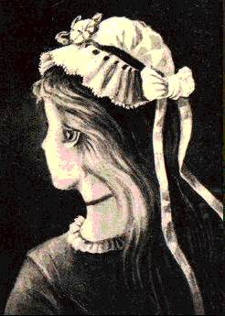
Young, or old?

Slide 10
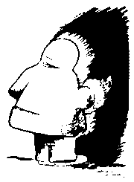
Native American . . . Or Eskimo?

Slide 11

Which line is longer?
A
B

